Slide 1
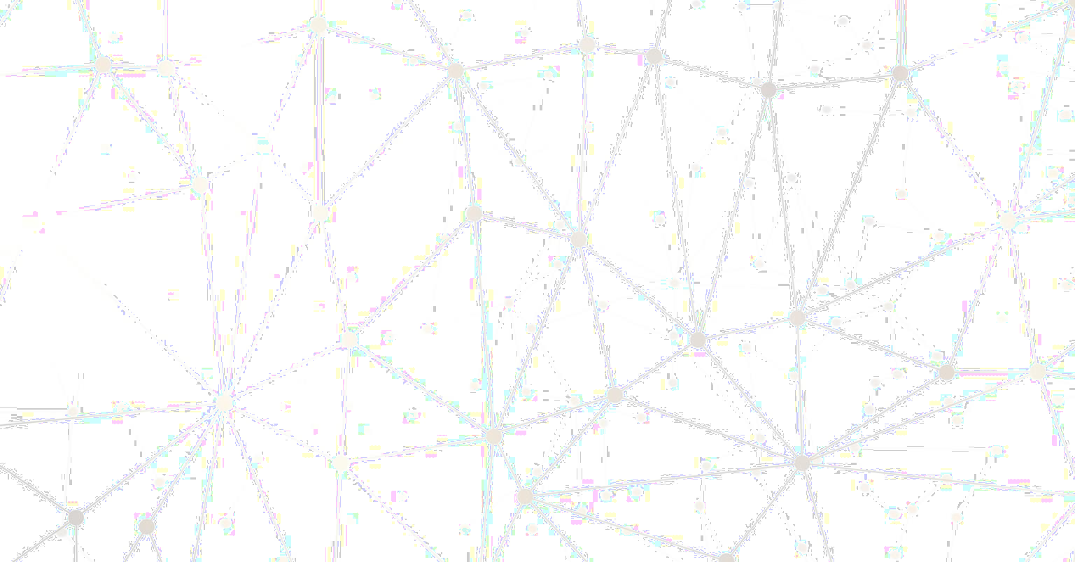




Federated Learning for Object Detection in Autonomous Vehicles
2021 IEEE Seventh International Conference on Big Data Computing Service and Applications (BigDataService)
Guided by:
Prof. C Krishna Mohan IIT Hyderabad
Presenter: Manan Darji CS22MTECH14004
IIT Hyderabad
Teaching Assistant:
Zarka Bashir IIT Hyderabad

Slide 2

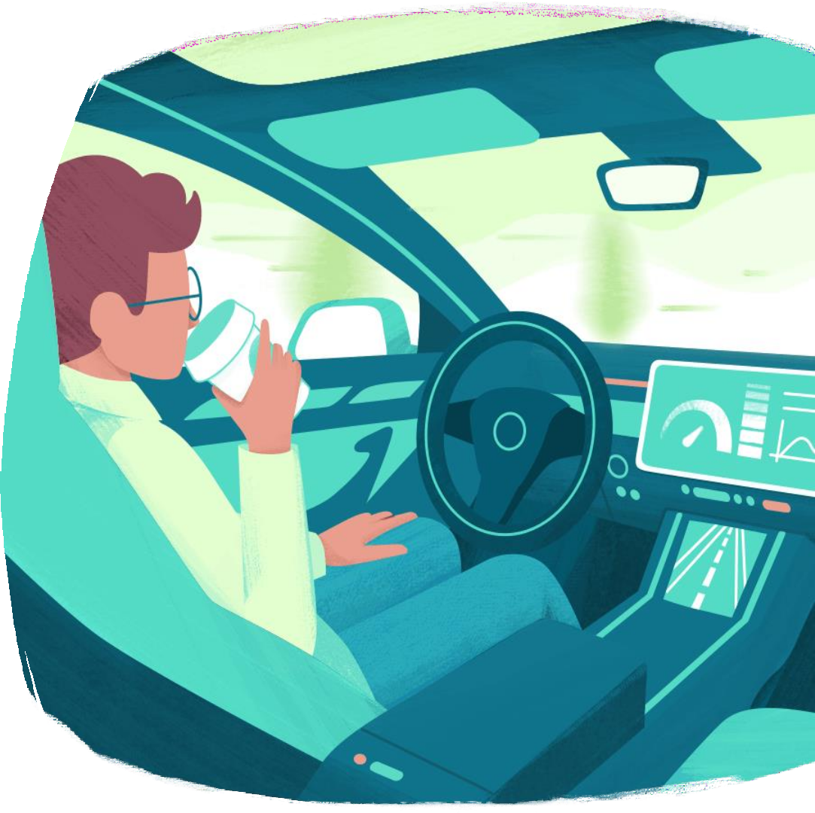
Contents:
Introduction
Literature review
Limitations (of previous work) and Motivation
Problem statement
Proposed method
Experimentation/results
Summarization
Future work
Img Referance

Slide 3

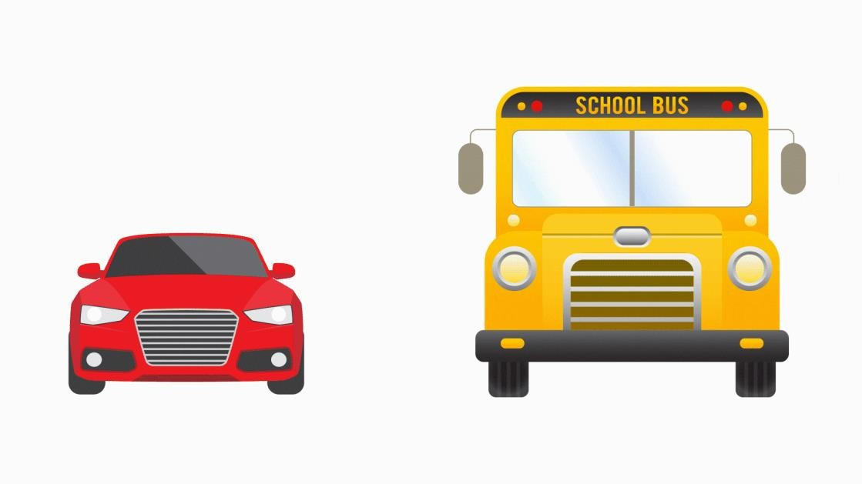
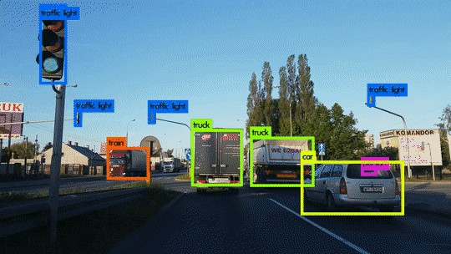
INTRODUCTION
Object Detection in Autonomous Vehicles
Object Detection is a process of finding all the possible instances of real-world objects.
It is one of the key features of Autonomous Driving Systems.
Bounding Box with classes [1]
Object Detection in Autonomous Vehicles [2]
[1] Object Detection | [2] Object Detection

Slide 4

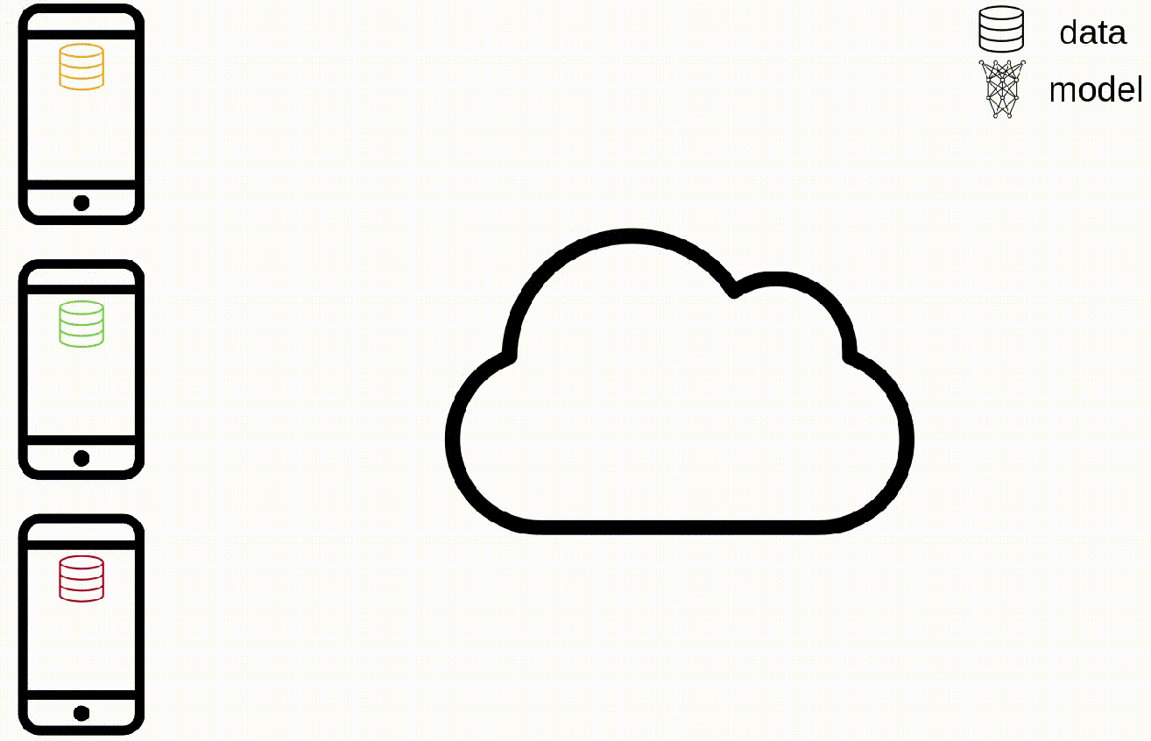
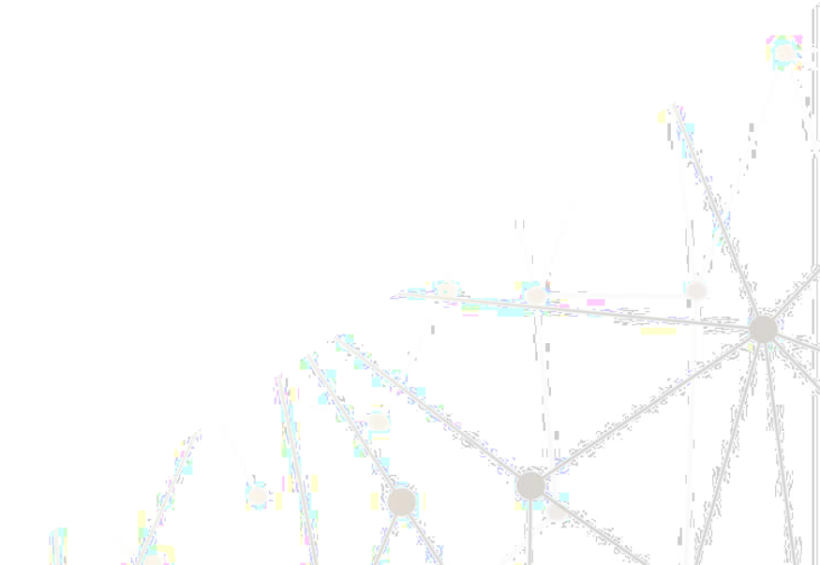
Federated Learning
Federated learning (also known as collaborative learning) is a machine learning technique that trains an algorithm across multiple decentralized edge devices or servers holding local data samples without exchanging them.
Train Model Locally
Sent parameters to
the Global server
Average over- trained models
Sent back New
Aggregated Model
[1] Federated Learning

Slide 5

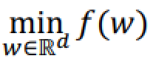
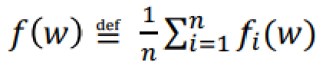
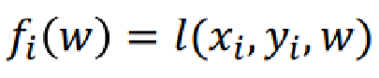
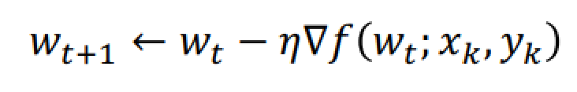
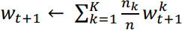
Federated Learning
In traditional Deep learning, we use mini-batches SGD to train our model.
Here X_{k} and Y_{k} are set of input and labels of size k.
Basically we are minimizing the Average loss over the selected mini-batch of size k.
So, we can consider every client in federated learning having data of K-size batches only.
There are two ways we can combine weights.
Each client k submits a gradient(g_{k}); the central server aggregates the gradients to generate a new model
Each client k computes W locally; the central server performs aggregation over all W

Slide 6

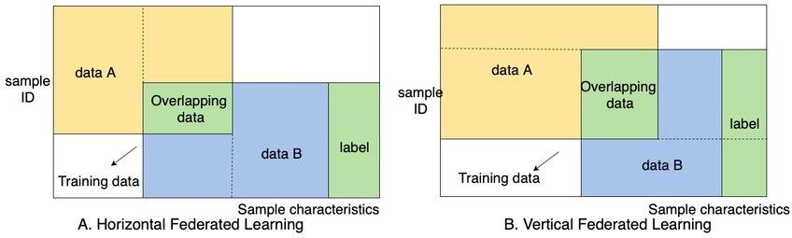
Federated Learning
Horizontal federated learning uses datasets with the same feature space across all devices, this means that Client A and Client B has the same set of features as shown in (A) below. Vertical federated learning uses different datasets of different feature space to jointly train a global model as shown in (B).
Types of Federated Learning [1]
[1] Types of Federated Learning

Slide 7

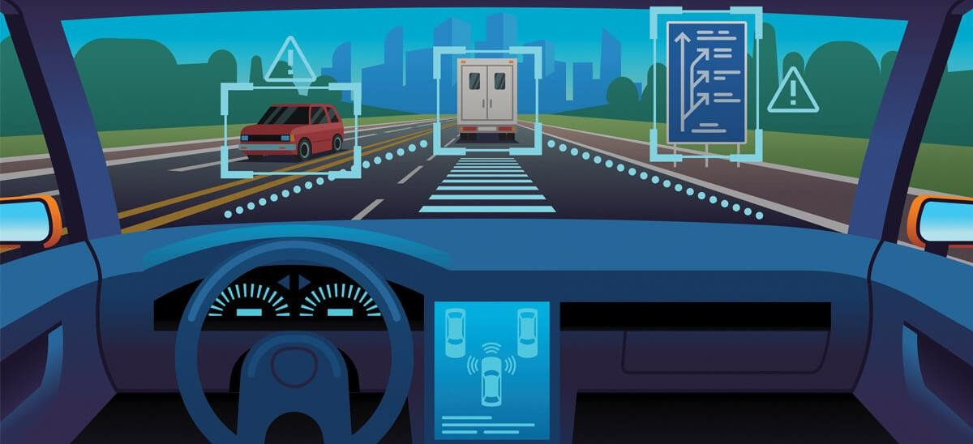
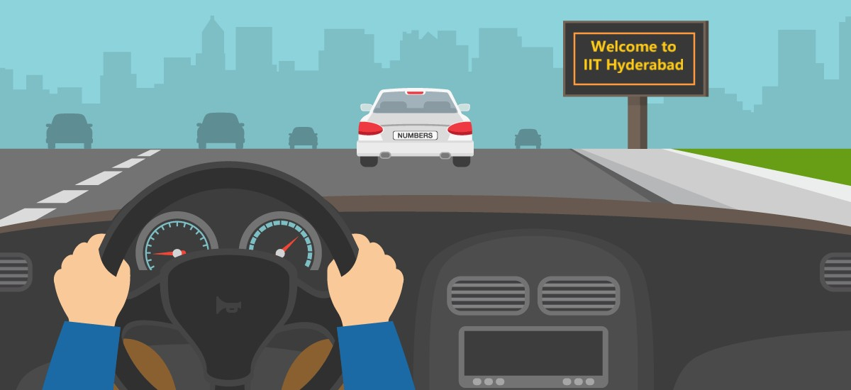
Literature review
Why do Autonomous vehicles have Privacy issues? It’s Not like “Medical Data”.
There is many application for Autonomous vehicles, like Driving assistance, Cruise control, Self-parking systems, or some vision-based toy device that you fix in your car. All this application gets the image/Video data from your edge device/car. That data could be
sensitive, like your current location or places you travel to, photographs of your residence, etc. So, consumers may not consent to share this data.
[1] Image | [2] Image

Slide 8

Literature review
The number of vehicles with autonomous features like Driving assistance, Cruise control, and Self- parking systems has been increasing globally.
The collaboration of Autonomous Driving Systems (ADS) and Deep Learning (DL) has improved the
performance of various tasks for self-driving vehicles.
For data-sensitive industries such as healthcare and “Autonomous vehicle”, it leaves a considerable privacy risk. Not only does centralized training has a privacy risk, but it also doesn’t adapt to the dynamic environment and each device well.
Companies providing autonomous driving solutions collect data from private vehicles that use their products, apart from collecting their own data through demo runs. However, consumers may not consent to share their driving data, for instance, the places they travel to or photographs of their residences. Collecting personal data also violates privacy regulations and policies.
In the scenario of the autonomous vehicle, federated learning empowers adaption to environment dynamics, providing feature learning in different geographical locations, weather conditions, pedestrians behavior dynamics.
[1] A Study of Federated Learning in Autonomous Vehicle System

Slide 9

Limitations (of previous work) and Motivation
Traditionally, object detection models are usually trained at a centralized location by collecting data from
multiple sources. This raises concerns about Data privacy among other issues.
We Know we need a lot of data to train Deep Learning models. If we collect all data from edge devices, it will, of course, increase the Upstream Data Load.
We also have to store all that data, which will also require some temporary storage on the server side.
To train on such large data, we need a lot of computing.
Of course, collecting data from private vehicles violate privacy regulations and policies in some cases.

Slide 10

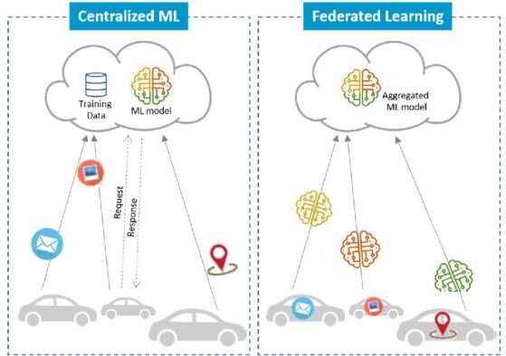
Problem statement
This paper will discuss the
implementation of a Federated Learning
prototype to train onboard vehicles.
object detection
Through this
prototype, we test the hypothesis that Federated Learning can yield performance comparable to traditional centralized deep learning while securing user data locally.
[1] Traditional vs. Federated Learning
[1] Traditional vs Federated Learning

Slide 11

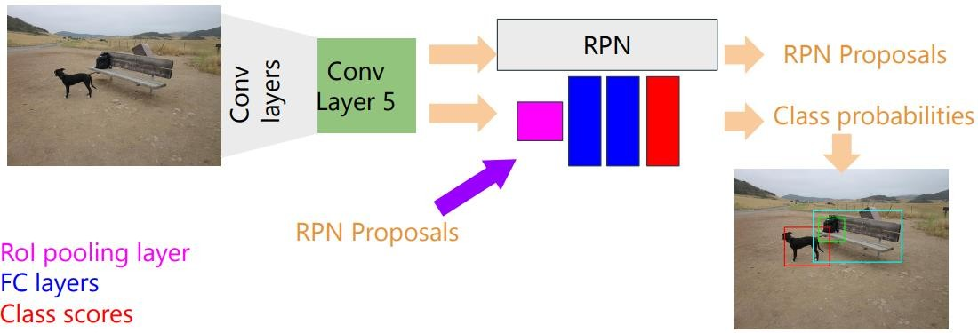

Proposed method
Legacy object detection techniques follow Discrete pipelines for extracting features, warping and classifying the images.
Traditional pipeline uses RPN (Region Proposal Network) with Faster R-CNN. Approximate joint training, where both RPN and R-CNN are trained together, is used to obtain the results faster.
Although eliminating the selective search speeds up the region proposal process, the R-CNN-based architectural frameworks require enormous region proposals, which are computationally expensive and inefficient. The solution to this problem is introduced as some Reinforcement Learning (RL) model for object detection.
A different approach to object detection is YOLO. Which is Developed as a Single Convolutional Network. Which localizes the object based on the class probabilities at a pace of ∼ 45 fps. The authors have used YOLO for this Prototype.

Slide 12

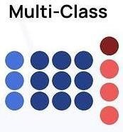
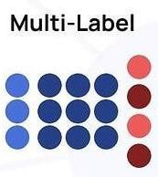
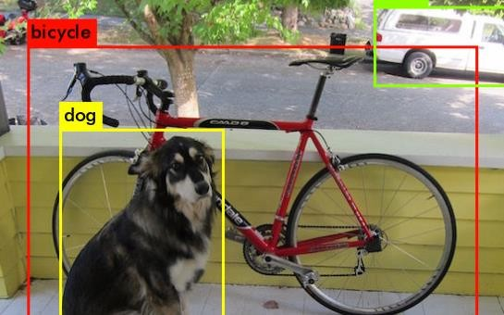
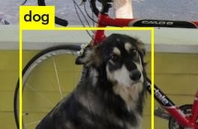
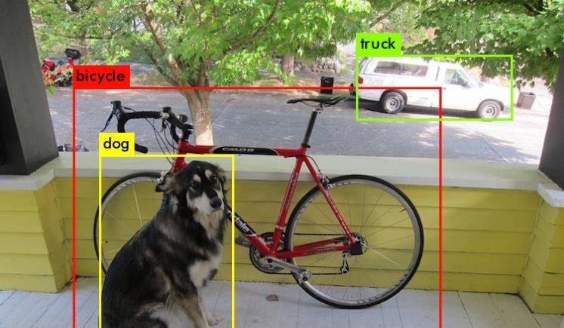
Proposed method
YOLOV3 Model for Object Detection
YOLOV3 [7] is one of the advanced versions of object detection frameworks.
[at that time]
Detect Multiple Objects
Predict Classes for Object
Identify the Location for Object

Slide 13

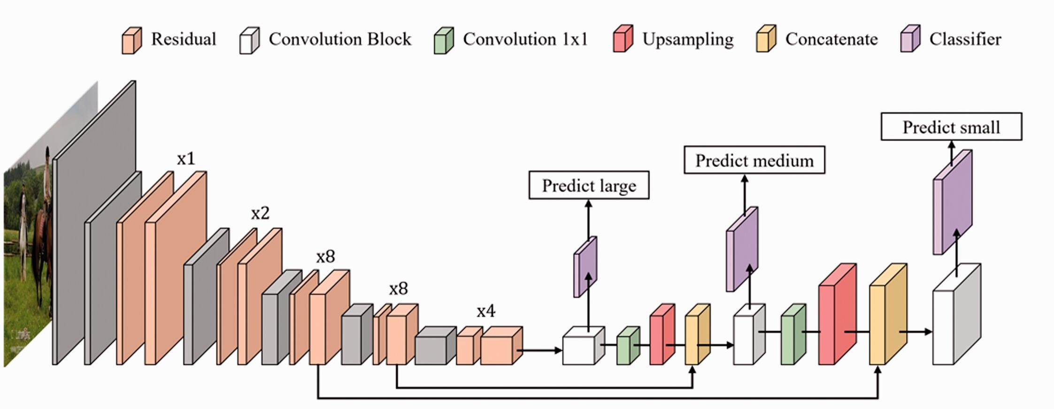
Proposed method
Yolo Architecture:
52 x 52 x *
26 x 26 x *
13 x 13 x *
It Contains 106 Layers.
Prediction at Layers 82, 94, & 106.

Slide 14

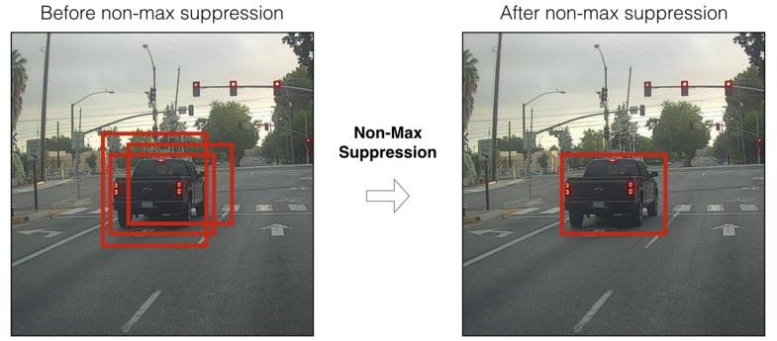
Proposed method
Non-maximum Suppression (NMS)
Input: A list of Proposal boxes B, corresponding confidence scores S and overlap threshold N.
Output: A list of filtered proposals D.
Algorithm:
Sort all the bounding boxes in the decreasing order of confidence scores.
Pick the first bounding box, which has the maximum score.
The next bounding box with the highest confidence is picked.
Repeat until all the bounding boxes above a threshold value are selected.
Image Refrence

Slide 15

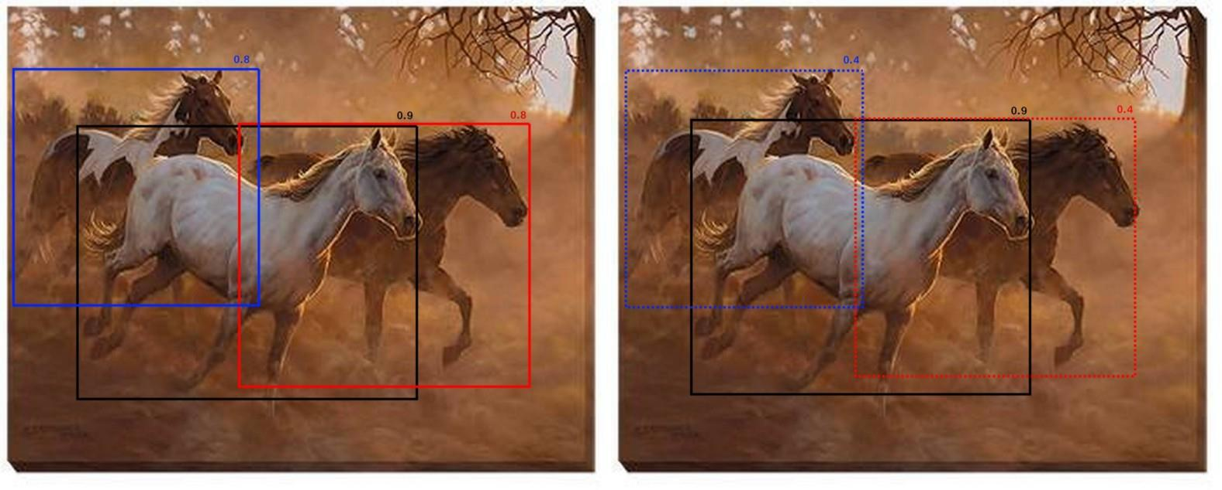
Proposed method
“instead of completely removing the proposals with high IOU and high confidence, reduce the confidences of the proposals proportional to IOU value”
This is called Soft-NMS.
Image Refrence

Slide 16

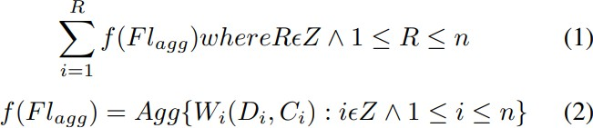
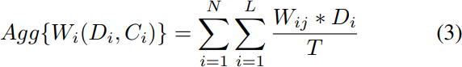
Proposed method
Authors Use horizontal federated learning with numerous clients C = {C1, C2, C3,. . . , Cn} to collaboratively perform object detection on their respective image data samples D {D1, D2, D3,. . . , Dn}.
Wi are the training weights obtained from client Ci, trained on
As defined in equation 2, the FL model is defined as a function of aggregated weights.
They do this for a given number of communication rounds, R between Server S and Clients C.
weights aggregation formula is defined in equation 3. For each client in C.
N = Number of clients
L = Number of layers of yolov3 model
T = Sum of total number of data samples from all
clients C.
Di = number of images used in training on client Ci for e number of epochs

Slide 17

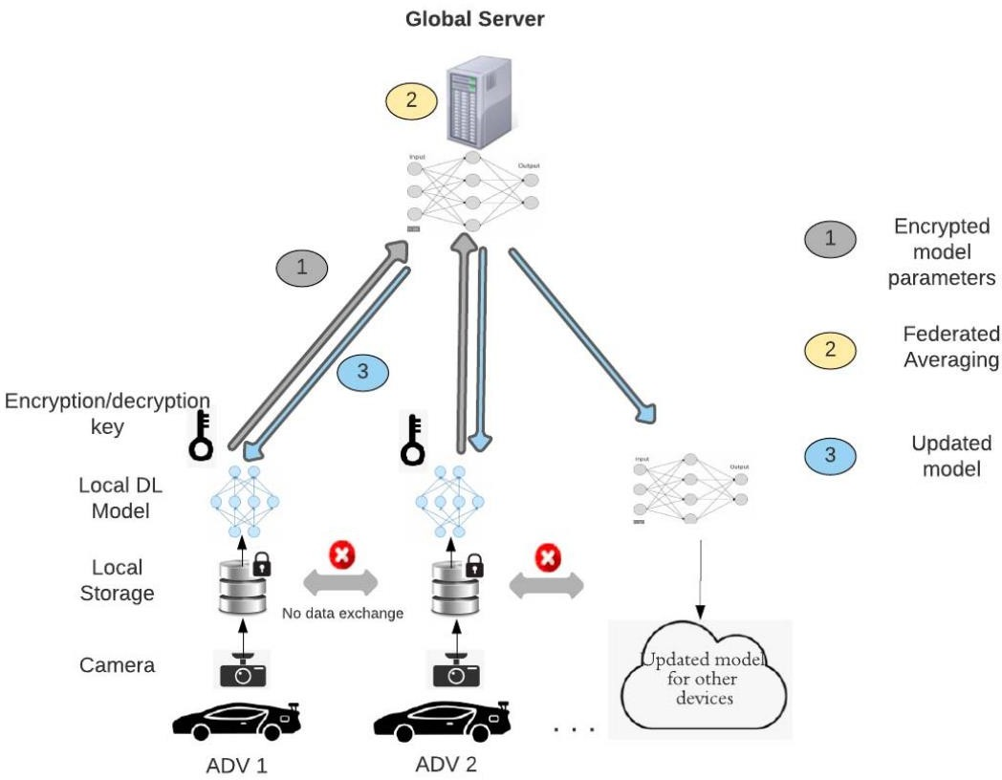
Proposed method
Architecture used :

Slide 18

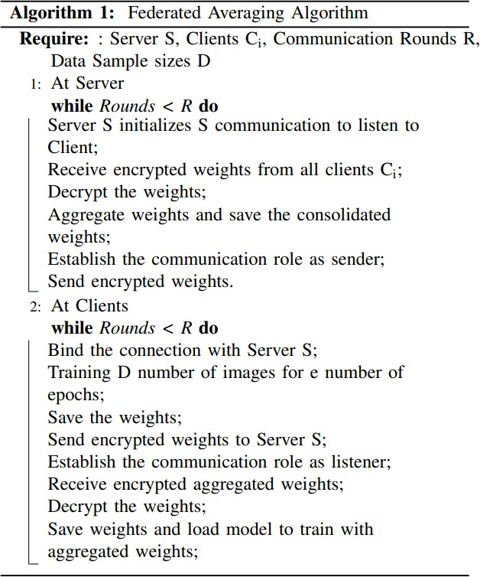
Proposed method
Federated Learning Algorithm:

Slide 19


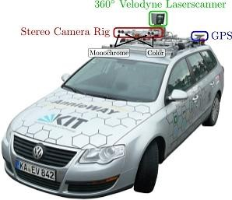
Dataset Used
Their tasks of interest are stereo, optical flow, visual odometry, 3D object detection and 3D tracking.
For this purpose, They equipped a standard station wagon with two high-resolution color and grayscale video cameras. Accurate ground truth is provided by a Velodyne laser scanner and a GPS localization system.
Their datasets are captured by driving around the mid-size city of Karlsruhe[Germany], in rural areas and on highways. Up to 15 cars and 30 pedestrians are visible per image.
https://www.cvlibs.net/datasets/kitti/index.php

Slide 20

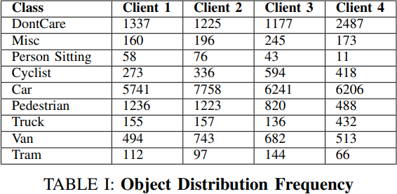
Dataset Used
Data set Used:
KITTI Vision Benchmark Dataset
It consists of 8 classes:
Car, Van, Truck, Pedestrian, Person sitting, Cyclist, Tram, and Misc.
Data Split Strategy:
Since KITTI dataset is imbalanced, in that ’Car’ and
’Pedestrian’ classes have more occurrences in
comparison to other classes.
Conversion to YOLO Format:
KITTI labels need to be converted to YOLO format, which is:
<object-class> <x> <y> <width> <height>
In our experiment, authors have deployed the YOLO algorithm in Tensorflow with Python. There are several hyperparameters of the model that has been tuned for better detection. Which I explore while implementing the code.

Slide 21

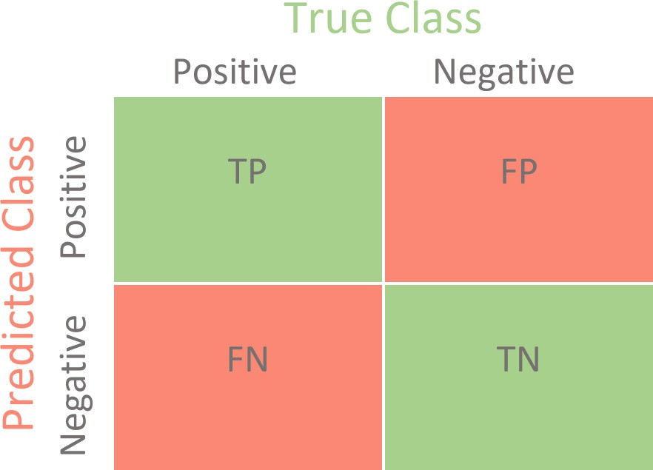
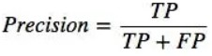
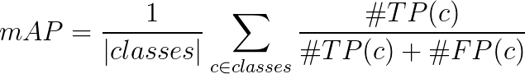
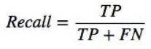
Experimentation/results
mAP
Precision:
is a measure of when "your model predicts how often does it predicts correctly?" It indicates how much we can rely on the model's positive predictions.
Recall:
is a measure of "has your model predicted every time that it should have predicted?" It indicates any predictions that it should not have missed if the model is missing.
The best model is the one with higher Precision as well as Recall.
mAP is one of the widely used metrics to measure the accuracy of object detection models based on all the
classes detected
Reference

Slide 22

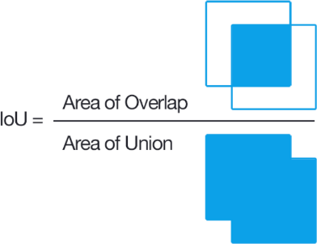
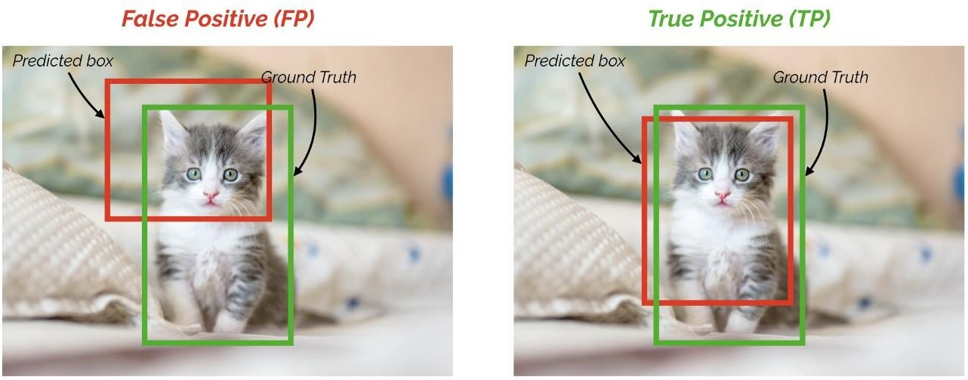
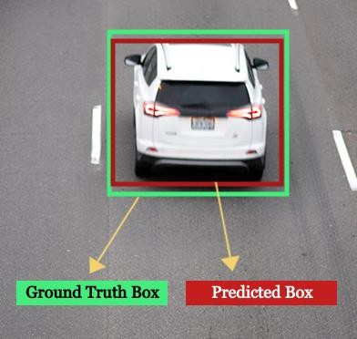
Experimentation/results
IoU (Intersection Over Union)
It is a measure of finding the area of overlap between two regions over the union of the two regions.
IoU is used for finding the percentage of overlap between predicting bounding
box values and ground truth bounding box values over the area of their union.
The IoU score value ranges from 0 to 1. The higher the IoU score, the better the prediction.
IoU = ~0.3
IoU = ~0.7
Reference

Slide 23

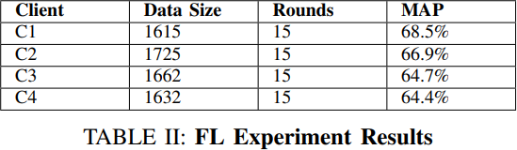
Experimentation/results
They ran object Detection using YOLO individually for the four clients for 5 epochs and repeated the process for 15 communication rounds.
They observe that although the model is trained for 5 epochs, the mean average precision value is considerably high.

Slide 24

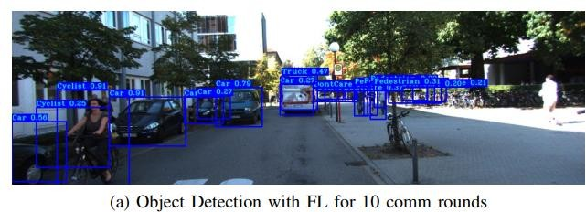
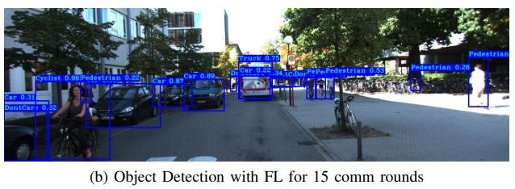
Experimentation/results
The figure shows the detection images for 10 and 15 communication rounds, respectively. There is a
considerable improvement
after indirectly gaining knowledge from
unseen data of other clients, in that objects are classified correctly, and pedestrian towards the right has been detected. These results demonstrate the working of the FL prototype.

Slide 25

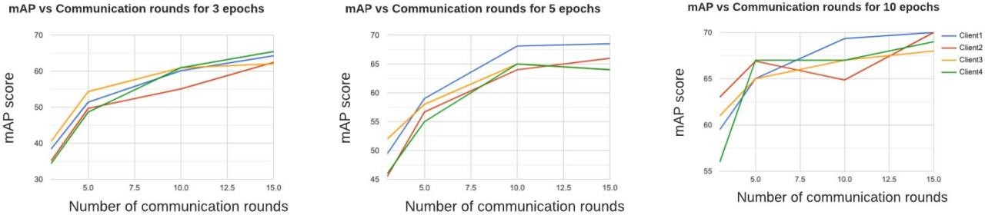
Experimentation/results
We further experimented with different numbers of epochs and communication rounds for the FL model. From the plots shown in figure [4], we infer that the model converges at mAP value of around 68%.
Increasing the number of epochs in the range of 3 to 5 to 10 shows a gradual increase in the mAP after each communication ro. However, the improvement in the model performance is negligible after reaching a precision score of 68% for all clients.

Slide 26

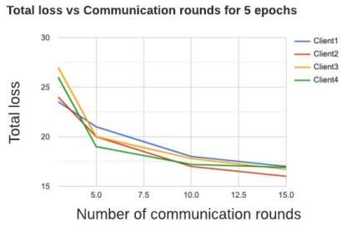
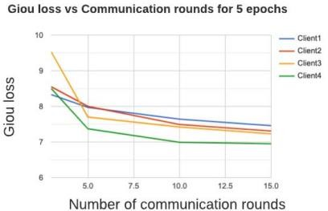
Experimentation/results
•
The plots of total loss versus the communication rounds for 5 epochs in figure 5 shows a gradual decrease in the losses until the model converges after 10 communication rounds.
Total Loss
Generalized Intersection over Union Loss

Slide 27

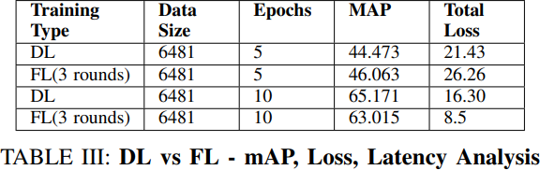
Experimentation/results
Comparison of Deep Learning with Federated Learning
6K images are trained using the YOLOV3 model on a centralized system for 5 and 10 epochs and the FL model where the same 6K images are distributed among 4 clients and where each client has YOLOV3 configured to run for 5 and 10 epochs and the weights are tuned using FL algorithm for 3 rounds.
It can clearly be inferred that the performances of FL and DL are comparable, where overall training loss and mAP are reduced and enhanced, respectively, with FL modeling. With the increase in communication rounds for FL, it is possible to achieve similar results as traditional models.
However, the interesting part is the time taken to complete the training. The FL model training takes a
lot less time than the traditional DL model training, thus reducing the resource needs.

Slide 28

Experimentation/results
They have shown that while training the 7K images of the KITTI dataset for one epoch on a single client took 27 minutes, the FL approach with data distributed among 4 clients took only 10 minutes. We can therefore deduce that the time taken is directly proportional to the data size.

Slide 29

Summarization
Authors have constructed and evaluated a prototype FL system on the KITTI Vision Benchmark 2D image dataset. Object detection models are trained locally on a vehicle’s dataset in their prototype. The resultant weights are securely aggregated at the global server using symmetric encryption techniques during data transfer to yield an improved model.
The FL model converged at 68% mean average precision. They compared object detection performance using FL to the traditional deep learning approach and noticed a significant difference between the two models.
We further analyzed the latency in an FL and non-FL system. While training the 7K images of the KITTI dataset for one epoch on a single client took 27 minutes, the FL approach with data distributed among four clients took only 10 minutes. It is important to note that latency in the above context is the time taken during the training phase of object detection. Network latency is considered to be negligible for this setup.
They deduced that the time taken is proportional to the data size.
At last, they said that FL and DL produce comparable results.

Slide 30

Possible Future Direction
Currently Trying to reproduce their results. (Code Improvement)
I might be changing The averaging algorithm used to batter one.
I might change YOLOv3 to other advance versions of YOLO.
If time permits, I would like to test this on a different data set (Like one with adverse weather conditions
suggested by TA).

Slide 31

References
D. Jallepalli, N. C. Ravikumar, P. V. Badarinath, S. Uchil and M. A. Suresh, "Federated Learning for Object Detection in Autonomous Vehicles," 2021 IEEE Seventh International Conference on Big Data Computing
Service and Applications (BigDataService), Oxford, United Kingdom, 2021, pp. 107-114, doi:
10.1109/BigDataService52369.2021.00018.
C. Bloom, J. Tan, J. Ramjohn, and L. Bauer, “Self-driving cars and data collection: Privacy perceptions of networked autonomous vehicles,” in Thirteenth Symposium on Usable Privacy and Security (SOUPS 2017). USENIX Association, Jul. 2017.
L. Chen, B. Li, and L. Qi, “Improved yolov3 algorithm for ship target detection,” in 2020 39th Chinese Control Conference (CCC), 2020, pp. 7288–7293.
Communication-Efficient Learning
of Deep Networks from Decentralized Data
https://arxiv.org/pdf/1602.05629.pdf
https://medium.com/@ys2223/a-study-of-federated-learning-in-autonomous-vehicle-system-ca9be70291fc
https://www.bitfount.com/pets-explained/federated-machine-learning

Slide 32


Thank you

